Slide 1

Basic Details of the Team and Problem Statement
Ministry/Organization Name/Student Innovation: All India
Council for Technical Education(AICTE)
PS Code: DR728
Problem Statement Title: Prediction of Admission & Jobs in Engineering & Technology/Management/Pharmacy with respect to demographic locations.
Team Name: ZERO+
Team Leader Name: RITHI NATCHATRA C
Institute Code: 3123
Institute Name: St.JOSEPH’S COLLEGE OF ENGINEERING
Theme Name: SMART EDUCATION

Slide 2

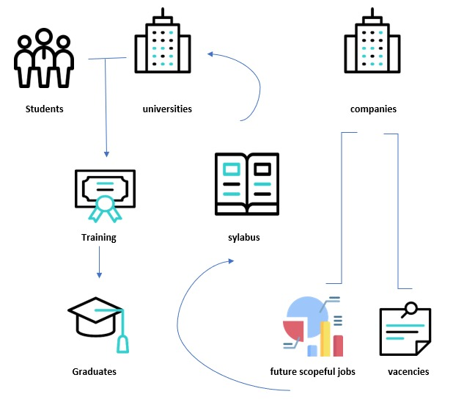
Idea/Approach Details
Every year more than 6 crores of Indians graduates from diverse backgrounds and with diversity in education . Almost all student who graduates opt for Jobs which has no root to their potential or as they wish which leads to lack of information of employment potential which ends up in unemployment.
Our mission through RECRUIT ME is to get to know the potential of each graduate and help them to define their own Definition to Success.
TECHNOLOGIES USED
Android Studio
Firebase: - Realtime Database
- Authentication.
Swipe cards
HTML
Map box
Bootstrap
Flexbox
DB MYSQL

Slide 3
Idea/Approach Details
USE CASE
DEPENDENCIES
You can use it to build connection in your Industry and to stay in touch with colleges .It’s a valuable tool for Job searchers and recruitment, and a great way to stay up to date with industry news , enhance your professional reputation, and increase the visibility of our brand.
External dependencies : Tie up with Universities and companies.
Third-Party dependencies : Mapbox , Tawk(Chatbot),Firebase(DB).
Related Information: http://recruit-me.netlify.app/

Slide 4
Team Member Details
Team Leader Name: C.Rithi Natchatra
Branch (Btech/Mtech/PhD etc): B.Tech Stream (ECE, CSE etc): IT Year (I,II,III,IV): III
Team Member 1 Name: S.Shriram
Branch (Btech/Mtech/PhD etc): B.Tech Stream (ECE, CSE etc): IT Year (I,II,III,IV): II
Team Member 2 Name: D.Shriman
Branch (Btech/Mtech/PhD etc): B.Tech Stream (ECE, CSE etc): IT Year (I,II,III,IV): II
Team Member 3 Name: S.Samyuktha Shanmugam
Branch (Btech/Mtech/PhD etc): B.Tech Stream (ECE, CSE etc): IT Year (I,II,III,IV): II
Team Member 4 Name: S.Sheryl Joanna
Branch (Btech/Mtech/PhD etc): B.Tech Stream (ECE, CSE etc): IT Year (I,II,III,IV): II
Team Member 5 Name: T S Varsha
Branch (Btech/Mtech/PhD etc): B.Tech Stream (ECE, CSE etc): IT Year (I,II,III,IV): III
Mentor Name: Venkatesan G
Branch (Btech/Mtech/PhD etc): B.Tech

